Slide 1
Personality Development and Soft Skills
Dr. Ranubala Marothiya
Sr Assistant Professor
Dept of Arts Humanities and Social Sciences
Medi-caps University, Indore

Slide 2
Personality
Personality is the ways in which an individual reacts and interacts with others.
The word is derived from a Latin word, meaning a mask, worn in classical times. Its therefore, is a mask you show the world, the part of you, you display to the world.
The deeply ingrained and relatively enduring patterns of thought, feeling and behavior.
It implies to all what is unique about an individual, the characteristics that makes one stand out in a crowd.
The sum total of individual’s Psychological traits, characteristics, motives, habits, attitudes, beliefs and outlooks.

Slide 3
Layers of Personality
Physical Aspect- outer appearance, colour, shape, size,
Mental Aspect- Thinking patterns, knowledge, memory, learning, acquisition,
Emotional Aspect- our emotions, feelings sensitivity
Spiritual Aspect- soul consciousness, universal consciousness

Slide 4
Personality Determinants
Heredity- Are generally considered to be either completely or substantially influenced by parents, that is by their biological, physiological and inherent psychological makeup.
Environment- That exert pressures on our personality formation are the culture, our early conditioning, the norms among our family, friends and social groups, and other influences that we experience
Situation- An individual’s personality although generally stable and consistent, does change in different situations. The varying demand of different situation calls forth different aspects of one’s personality. We should not therefore look upon personality patterns in isolation.

Slide 5
TOPICS TO BE COVERED
Self Awareness
Self Esteem
Attitudes
Assertiveness
Time management
Stress Management
Conflict management
Communication skills
Presentations Skills
Body Language
Grooming

Slide 6
Self Awareness
Socrates said- “ Know Thyself”
Marcus Aurelius on Self-improvement said,“Be Thyself”
Identifying and understanding who we are and what makes us function.
Through self-awareness one “develops the ability to know how you are feeling and why, and the impact your feelings have on your behaviour.
Kelly suggests we have ‘Core constructs’; those which are more personal to us and define our identity ‘Peripheral constructs’ may be about others and our environment, and even about our self.

Slide 7
Benefits of Self Awareness
Understanding yourself in relation to others
Developing and implementing a sound self-improvement program
Setting appropriate life and career goals
Developing relationships with others
Understand the value of diversity
Managing others effectively
Increasing productivity
Increasing your ability to contribute to Organizations, your community and family.

Slide 8
Self Awareness
How to Gain
Self-analysis
Behaviour
Personality
Attitudes
Perceptions
Self-disclosure
Diverse Experiences:

Slide 9
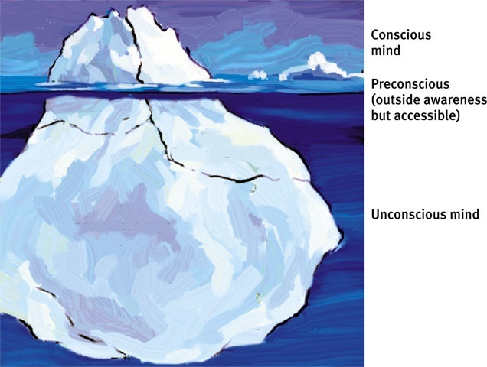
Model of Mind The mind is like an iceberg. It is mostly hidden, and below the surface lies the unconscious mind. The preconscious stores temporary memories.

Slide 10
The Johari Window
Known to self Unknown to self
Blind Area
Known to Others
Unknown to Others
Open/Free Area
Hidden Area
Unknown Area

Slide 11
SWOT Analysis
It is not always easy to look at our own effectiveness with a clear and unbiased attitude. SWOT is tool that can be used to analyse ourselves.
S - Strengths
W - Weaknesses
O - Opportunities and
T- Threats.
making reference to your own personal traits.
From your analysis you should identify your own development needs and abilities
If this is the case, you may have to do some training, reading or undertake reflection of some kind.
For SWOT to work for you, you must be honest with yourself!

Slide 12
Habits
A habit is an activity that is acquired, done frequently, done automatically, and difficult to stop.
Forming good habits: Stephen R Covey presented a framework of habits for personal effectiveness in his best seller “7 Habits of Highly effective people”
In today's challenging and complex world, being highly effective is the price of entry to the playing field.

Slide 13
Habits
To thrive, innovate, excel, and lead in this new reality, we must reach beyond effectiveness toward fulfillment, contribution, and greatness.
Research is showing, however, that the majority of people are not thriving. They are neither fulfilled nor excited.
Tapping into the higher reaches of human motivation requires a new mindset, a new skill-set --a new habit.

Slide 14
Self Esteem
Your opinion of yourself.
Self-esteem is the foundation for emotional well-being. It is one of the most fragile of human elements.
High self esteem-a good opinion of yourself
low self esteem- a bad opinion of yourself.
Poor Self-Esteem vs. Healthy Self-Esteem
Where Does Self-Esteem Come From?
Self Efficacy
Self-motivation

Slide 15
Keys to Increasing Self-esteem:
We become what we contemplate.
Listen to Self-Talk
Recognize Accomplishments
Be Assertive: Say what you mean and respect what others say.
Practice clear communication.
Have tolerance, Patience and persistence
Do not be afraid to admit a mistake; just learn from it.
Build a Support System:
Take action Take comfort in the fact that self–awareness is an ongoing pursuit
Discover how others have worked on their self–awareness
Find out how to form new patterns of thinking

Slide 16
Attitude Building
An Attitude can be defined as a persistent tendency to feel and behave in a particular way toward some object.
Attitudes are the results of beliefs.
Attitudes can be broken down into 3 basic components:
· Emotional
· Informational
· Behavioral
Factors that determine our attitude
· Environment
· Experiences
· Education

Slide 17
Types of attitude
Positive attitude
Negative attitude
Neutral attitudes

Slide 18
Assertiveness
An assertive style of behavior is to interact with people while standing up for your rights without violating the rights of others.
The result of being assertive is that -you feel good about yourself and other people know how to deal with you and there is nothing vague about dealing with you.
It is appropriately direct, open, and honest communication which is self-enhancing and expressive.

Slide 19
Assertiveness
Allow you to feel self-confident and will generally gain you the respect of your peers and friends.
Increase your chances for honest relationships, and help you to feel better about yourself and your self-control in everyday situations.
Improve your decision-making ability and possibly your chances of getting what you really want from life.

Slide 20
Body language as related to Assertive Behavior:
Eye contact and facial expression: Maintain direct eye contact; appear interested and alert, but not angry.
Posture: Stand or sit erect, possibly leaning forward slightly.
Distance and contact: Stand or sit at a normal conversational distance from the other.
Gestures: Use relaxed, conversational gestures.
Voice: Use a factual, not emotional tone of voice. Sound determined and full of conviction, but not overbearing.
Timing: Choose a time when both parties are relaxed. A neutral site is best

Slide 21
Time Management
To choose time is to save time.- Bacon, Francis
Time management is commonly defined as the various means by which people effectively use their time and other closely related resources in order to make the most out of it.
Benefits of Time Management:
Reduce frustration and Anxiety
Get a sense of achievement and peace of mind
Open yourself to more satisfaction
Increase your energy level
drastically improve the more of quality time

Slide 22
Time Management Tools
Time management starts with the commitment to change.
commitment to action.
You can train others to get work done
Self knowledge and goals
Developing and maintaining a personal, flexible schedule: create a schedule that works for you, not for others.
Prioritising, delegating; controlling your environment, understanding yourself and identifying what you will change about your habits, routines and attitude, conditioning, or re-conditioning your environment.
Think of times when you can study "bits" as when walking, riding the bus, etc.

Slide 23
Stress Management
Common human phenomenon and part of life.
Occurs when the pressure is greater than the resource
Not necessarily harmful. Mild forms of stress can act as a motivator and energizer. If level is too high, medical and social problems can result.
Definition of stress by Richard S Lazarus, “is that stress is a condition or feeling experienced when a person perceives that “demands exceed the personal and social resources the individual is able to mobilize.” In short, it's what we feel when we think we've lost control of events.
It’s “wear and tear”, our minds and bodies experience as we attempt to cope with our continually changing environment.

Slide 24
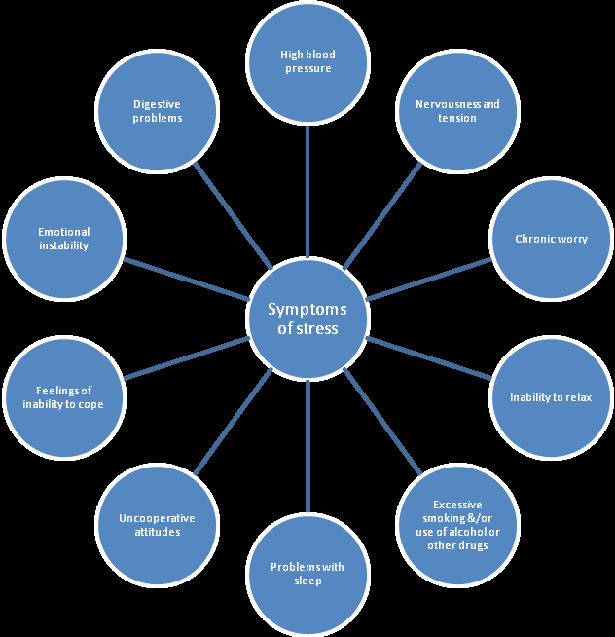

Slide 25
Identify Personal Stressors
Relationships
Environment
Work or school-
Social
Internal
Job demands
Job security
Relations with your supervisor and co-workers

Slide 26
Positive Ways to Cope with Stress
Exercise. Eat healthily and get regular sleep.
Escape for awhile.
Eliminate small hassles wherever possible.
Breathe, try relaxation or meditation. Draw on spirituality
Be realistic. Don't try to be superhuman: be realistic and don’t expect too much from yourself
Set priorities and goals. Take time for you.
Listen to your body as to how much sleep you need
Note the positive
Laugh
Talk to others. Don't bottle up your feelings, reach out to those you trust

Slide 27
Conflict
Conflict is when two or more values, perspectives and opinions are contradictory in nature and haven‘t been aligned or agreed about yet, including:
Within yourself
When your values and perspectives are threatened or any fear
Conflict is inevitable and often good, for example, good teams always go through a "form, storm, norm and perform" period.

Slide 28
Conflict is often needed
Helps to raise and address problems.
Energizes work to be on the most appropriate issues.
The conflict isn't the problem - it is when conflict is poorly managed that is the problem.
Conflict is a problem when it:
· Hampers productivity.
· Lowers morale.
· Causes more and continued conflicts.
· Causes inappropriate behaviors.

Slide 29
Art of Communication
The word "communication" is derived from "communis" (Latin), meaning" common". It stands for a natural activity of all human beings to convey opinions, feelings, information, and ideas to others through words (written or spoken), body language, or signs.
Communication is a two way traffic. You talk as well as listen
Communication is a sharing of knowledge, experience, feelings, ideas and even innovations.
Importance of Words (7-10%), Music (30-40%)and Body language (50%) in communication

Slide 30
Forms and types of communication
Verbal communication:
Oral communication
Written communication
Non-verbal communication:
Body language
Sign language
Para language
Space, surrounding and time

Slide 31
Non-verbal communication
It is culturally bound
Used to supplement verbal communication by highlighting or reinforcing parts of a verbal message
Most basic part in fact
Unconscious part of our behavior which is deeply rooted part in our entire makeup .Can be intentional or unintentional
For exchanging information between persons. It is done through sign language, action language, or object language
It is a wordless message conveyed through
gestures (sign), movements (action language), and
object language (pictures/ clothes)
Chinese proverb says – “A picture speaks thousand words

Slide 32
Non-verbal communication
body language, and kinesics),
personal space (proxemics)
touch (haptics),
eyes (oculesics),
sense of smell (olfactics),
time (chronemics).
Para Language and language of Sign Colour and symbols

Slide 33
Guidelines for effective communication-1
Know the great power the words have on people
Know objectives of Communication
Take an intelligent and vital interest in the world and people. Cultivate right attitude. Talk in terms of others man’s interest
Don’t exhibit superior Knowledge. Talk down to earth. Dont talk about yourself.
Don’t monopolize conversation
Be constructive and take others criticism positively
Inject a cheerful note in your conversation .Amuse as well as instruct
Be gracious in appreciating people and events but don’t talk personal questions. Give others limelight

Slide 34
Guidelines for effective communication-2
Take sufficient time to effectively communicate.
Learn to be empathic, honest and sincere.
Develop a sense of belonging when interacting with others. Be welcoming and inclusive.
Regularly, in your daily life, interact with persons whose culture, race, ethnicity and other identifiers and important characteristics are different than your own.
Spend quality time with persons whose backgrounds are different than yours.

Slide 35
Guidelines for effective communication-3
Learn to pronounce names correctly. Make a concerted effort to do so and to remember names.
Do not make assumptions.
Ask questions and achieve dialogue to attain successful communication.
Be a good listener.
Learn to understand others’ belief system. Be respectful of what others value.
Words are dynamite . Know this

Slide 36
Guidelines for effective communication-4
Understand the body language of others. Effective communication relates to nonverbal behavior and tone of voice, as well as words spoken.
Maintain positive dialogue even when there are differences in opinions and beliefs; do not attack the person. Learn from differences.
Be specific and concise.
Do not make discriminatory remarks or display discriminatory actions, as others learn from what you say and do. Be a positive role model.

Slide 37
Guidelines for effective communication-3
There are small strategies you can perform daily, too, such as:
listen to English radio or watching TV
read magazines
watch your colleagues closely and adapt your skills accordingly
practice with friends or family
give a mock speech

Slide 38
Presentation skills
Objectives
Audience
Matter
Rehearsal
Delivery of Content
Voice ,Poise and Posture
Role of Audio-Visual aids

Slide 39
Personal grooming
Know appearances are not always deceptive. They are usually revealing
When you are fresh and well groomed, it creates a positive impression.
Research has shown that good looking people have a 20% advantage over the not so groomed ones. Here are some basic rules
1. showers
2. Hair
3. Eyes, nose and ears
4. Teeth
5. Nails
6. Toes and feet

Slide 40
Grooming –men
Shoes: a good pair of leather shoes-black and brown/tan shoes. Must be polished everyday. Avoid that look casual. No wear shoes with worn out heels.
Belts: only formal belts with a sleek buckle. As thumb rule, match your belt to your shoes.
Watches: Preferably wear leather strapped watches. If wear a metal strapped watch, make sure that it fits the wrist well
Hairstyles: clean and neat, avoiding extreme styles or colors, trimmed above the collar leaving the ear uncovered.
Sideburns not extend below the earlobe or onto the cheek. Mustaches should be neatly trimmed and may not extend beyond or below the corners of the mouth.
clean shaven; beards are not acceptable.
Earrings and other body piercing are unacceptable.

Slide 41
Grooming –men
DRESS- the simpler the better.
Shirts- white, off white, pale, blue shirts are preferred; may wear dark colored shirts too. Button up your shirt till the collar button
Trousers- preferably be dark though, may wear beige and with a dark colored shirt.
Ties: choose a traditional silk tie, No loud colors or patterns. Avoid ties with images and designer logos. It should co-ordinate with your attire the knot should be a perfect triangle. Observe the tie and the shirt button.
Socks: a color that coordinates with your trousers. Make sure they are long enough not to expose your skin when you sit down. Avoid bad odour.

Slide 42
Grooming –women
DRESS: Salwaar kameez or formal shirt/trousers. Preferably choose small prints or self colors. Avoid tight fitting clothes ,You may wear a tunic with a pair of formal trousers.
Hair: extreme styles or colorations, or unnatural colors
Shoes/sandals: Shoes with 1 ½-inch heels are standard, may wear a pair with smaller heels or a flat pair. Stick with a black/brown pair. Be sure your shoes are polished and that your heels are intact. Avoid heels and sandals with heels. Avoid white colored sandals as they get dirty easily. If you do, clean them well
Bags: preferably, carry ablack or a brown one

Slide 43
Grooming
Accessories:
Earrings: Wear stubs or small rings. Do not wear hoops or dangling earrings.
Bracelets/Bangles: wear either a bracelet or a bangle. Avoid both. Avoid chunky bracelets or too many bangles.
Rings: Keep them simple and not chunky.
Chains: You may wear thin chains with small lockets.

Slide 44
In last
“God grant me the serenity to accept the things I can not change, courage to change the things I can, and wisdom to know the difference.”
Thank you
For With God nothing shall be impossible Luke 1:37

